Slide 1

ArtistGAN: EFFECTIVE GENERATION OF HUMAN FACE IMAGES USING TEXTUAL DESCRIPTION
UNDER THE GUIDANCE OF
Dr. Sushama Nagpal
RAJAT SINGHAL 327/CO/15
RATTANDEEP SINGH 331/CO/15

Slide 2
PROBLEM STATEMENT
To generate images of human faces from their descriptions given in textual format.
Notes:
No state-of-the-art model to generate human faces from their descriptions given.
Aim here is to generate an image that can be used as a reference for future aspects.

Slide 3
PROBLEM STATEMENT
To generate images of human faces from their descriptions given in textual format.
Face Description

Slide 4
PROBLEM STATEMENT
To generate images of human faces from their descriptions given in textual format.
Face Description
ArtistGAN

Slide 5
PROBLEM STATEMENT
To generate images of human faces from their descriptions given in textual format.
Face Description
ArtistGAN
Face Image

Slide 6

MOTIVATION
Ever wondered how sketch artists trace the faces of criminals when an eyewitness is describing him.
Ever tried to visualize the face of a character while reading a novel.
Can animated movie characters be created from a given script.
Notes:
Memes Generating faces based on Random description

Slide 7
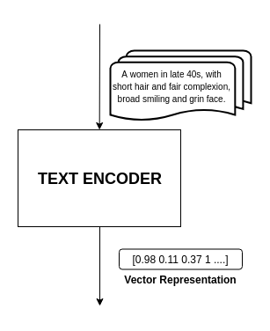
INTRODUCTION
Humans can easily interpret the textual descriptions but it hard to do so by machines. So, the first step is to vectorise the descriptions.
Notes:
Why vectorisation is required
We can quantify the results
It improves the learning ability of the models

Slide 8
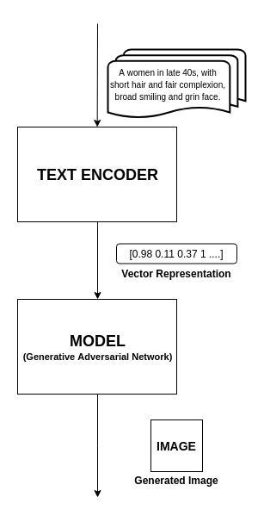
INTRODUCTION
Next, the vector representations are fed into our model which aims at producing the images that are relevant to the given description and are realistic.

Slide 9
INTRODUCTION
Generated Image
IMAGE
Now once we have an acceptable image, we try to enhance its details further. This tuning of features of image ensures that the resulting image is as close as expected by the critic.
Feature Tuning
Set of extrapolated images
Moving along feature axis

Slide 10
LITERATURE SURVEY
Research Paper | Publication | Work Proposed | Remarks
Generative Adversarial Text to Image Synthesis | Proceedings on 33rd International Conference of Machine Learning | Converts text(flowers and birds) to images using DCGan. | Training is unstable and no scaling for higher resolution.
StackGAN | 2017 IEEE International Conference on Computer Vision | Trained GAN in 2 stages and generate photo-realistic images. | Very huge amount of training time required for multiple stages
Generative Adversarial Text to Image Synthesis: Reed, S.E., Akata, Z., Yan, X., Logeswaran, L., Schiele, B., & Lee, H. (2016). Generative Adversarial Text to Image Synthesis. ICML.
Stack GAN: Zhang, H., Xu, T., Li, H., Zhang, S., Huang, X., Wang, X., & Metaxas, D.N. (2017). StackGAN: Text to Photo-Realistic Image Synthesis with Stacked Generative Adversarial Networks. 2017 IEEE International Conference on Computer Vision (ICCV), 5908-5916.

Slide 11
LITERATURE SURVEY
Research Paper | Publication | Work Proposed | Remarks
Conditional GAN | Computer Vision and Pattern Recognition, Machine Learning | Novel method to train GAN, using conditioning variables. | Used the technique applied for feeding labels.
Progressive growing of GAN | 2018 International Conference of Machine Learning | Generates stable and higher resolution images. | Needs large amount of initial dataset.
Conditional GAN: Mirza, M., & Osindero, S. (2014). Conditional Generative Adversarial Nets. CoRR, abs/1411.1784.
Progressive GAN: Karras, T., Aila, T., Laine, S., & Lehtinen, J. (2017). Progressive Growing of GANs for Improved Quality, Stability, and Variation. CoRR, abs/1710.10196.

Slide 12
LITERATURE SURVEY
Research Paper | Publication | Work Proposed | Remarks
FaceNet | IEEE Computer Vision and Pattern Recognition (CVPR) 2015 | Facenet system is used to map face images to fixed size embeddings. | Used pretrained FaceNet model to calculate accuracy of our model.
Facebook Infersent | EMNLP 2017 | Proposes a supervised technique to obtain embeddings of sentences. | Fixed size output from the model is of large dimension to be useful in practical applications of GAN.
FaceNet: Schroff, F., Kalenichenko, D., & Philbin, J. (2015). Facenet: A unified embedding for face recognition and clustering. In Proceedings of the IEEE conference on computer vision and pattern recognition (pp. 815-823)
Facebook Infersent: Conneau, Alexis & Kiela, Douwe & Schwenk, Holger & Barrault, Loïc & Bordes, Antoine.(2017). Supervised Learning of Universal Sentence Representations from Natural Language Inference Data. 670-680. 10.18653/v1/D17-1070.
Notes:
Facenet - distance between embeddings directly relates with similarity between faces.

Slide 13
PROPOSED WORK

Slide 14
FLOW CHART

Slide 15
Collect descriptions of the faces
Data pre-processing and cleaning
Convert textual descriptions to vector form
Images from Dataset
Training model to produce images
Generating new images using the trained model
Feature tuning of images and producing varied results.

Slide 16
DATASET DESCRIPTION
Image dataset : 1. Labelled Faces in the Wild (LFW) 2. CelebA
Descriptions: Face2Text (400 image descriptions)
Number of Image-Description pairs: 2493
Notes:
Descriptions are Edited and extended
Only Face related information

Slide 17
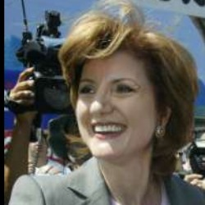
{
"img_id": 5,
"image": "Arianna_Huffington/Arianna_Huffington_0001.bmp",
"descriptions": [
{
"desc_id": 69,
"text": "This woman seems to be in her 40s or early 50s with a bright smile. She has a pale complexion and is well-groomed."
},
{
"desc_id": 807,
"text": "A middle aged woman looking happy and is smiling. She has lovely white teeth, is well dressed and has a smart look about her. She has brown eyes and pale skin and a short haircut."
}
]
}
LFW: Gary B. Huang, Manu Ramesh, Tamara Berg, and Erik Learned-Miller.Labeled Faces in the Wild: A Database for Studying Face Recognition in Unconstrained Environments.University of Massachusetts, Amherst, Technical Report 07-49, October, 2007.
Face2Text: Face2Text: Collecting an Annotated Image Description Corpus for the Generation of Rich Face Descriptions A Gatt, M Tanti, A Muscat, P Paggio, RA Farrugia, C Borg, KP Camilleri,,Proceedings of the Eleventh International Conference on Language Resources

Slide 18
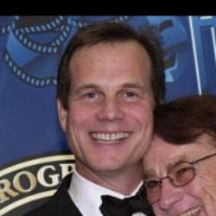
{
"img_id": 22,
"image": "Bill_Paxton/Bill_Paxton_0001.bmp",
"descriptions": [
{
"desc_id": 797,
"text": "A smiling middle aged man wearing a smart suit. He is wearing a sincere wide smile on his face showing that he is currently happy. “
},
{
"desc_id": 803,
"text": "This is a happy face and it also looks like the face of someone who has just said something witty and has made others laugh. The smile has wrinkled his face. His eyes look alert and are also laughing."
},
{
"desc_id": 1389,
"text": "A happy man in his mid thirties with a long face and a high forehead with brown eyes and a large toothy mouth with smartly combed short hair with a side parting"
}
]
}
LFW: Gary B. Huang, Manu Ramesh, Tamara Berg, and Erik Learned-Miller.Labeled Faces in the Wild: A Database for Studying Face Recognition in Unconstrained Environments.University of Massachusetts, Amherst, Technical Report 07-49, October, 2007.
Face2Text: Face2Text: Collecting an Annotated Image Description Corpus for the Generation of Rich Face Descriptions A Gatt, M Tanti, A Muscat, P Paggio, RA Farrugia, C Borg, KP Camilleri,,Proceedings of the Eleventh International Conference on Language Resources

Slide 19
ARCHITECTURAL FRAMEWORK

Slide 20
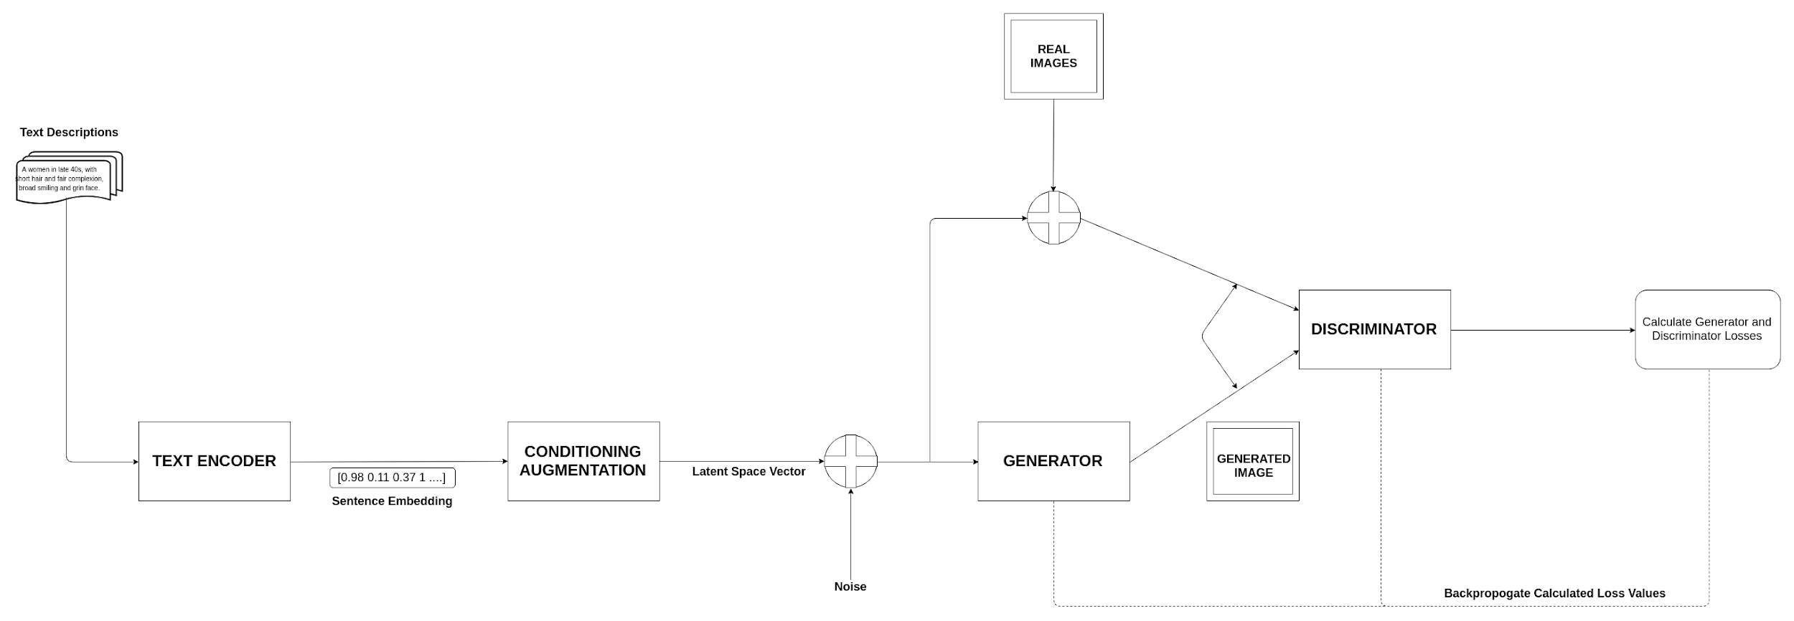
ArtistGAN Architecture

Slide 21
TEXT ENCODER

Slide 22

TEXT ENCODER: SENTENCE EMBEDDING
Embeddings are learned representations of text as a vector of numbers.
DIMENSIONALITY REDUCTION - It is more efficient representation.
CONTEXTUAL SIMILARITY - It is more effective representation.
Notes:
Distance is directly proportional to contextual similarity
Similar objects seem to have similar representation in embedding space
Figure of speech

Slide 23
TEXT ENCODER: SENTENCE EMBEDDING
Output
Sentence
Embedding
LSTM Layer
LSTM Layer
Embeddings
hair
long
has
Man
Architecture of Text Encoder

Slide 24
CONDITIONING AUGMENTATION
Notes:
Latent space is hidden compressed representation of image

Slide 25
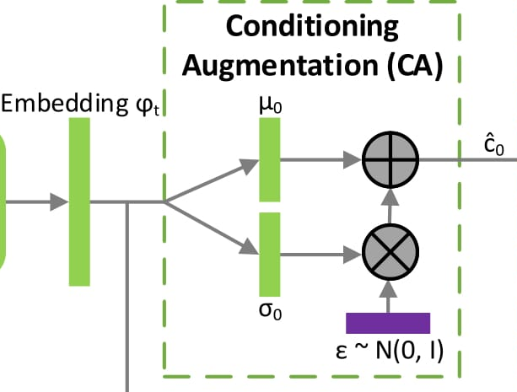
Need of Conditioning Augmentation
Problems before using CA | Effects after using CA
High dimensional text embeddings (usually >100) causes discontinuity | Provide continuity in latent space manifold Increase smoothness of the curve
Sentence to image is not one-to-one representation, as same sentence corresponds to various poses and appearance | Introduces randomness in the latent space manifold
ĉ₀ = μ₀ + σ₀ ◦ ∊,
∊ ~ N(0, I)
Notes:
Technique used to generate conditional latent manifold for the input to the generator.
CA helps stabilise the training and improve the diversity of the generated samples.

Slide 26
GENERATIVE ADVERSARIAL NETWORKS (GAN)
Notes:
Learns to generate new samples from the training distribution. - GENERATIVE MODEL
Training 2 neural network
Generative neural network - create millions of new images
Discriminator network - judges whether these images are real or fake
Generative network improve its game by feedback by generating more and more realistic looking images while discriminative network gets better and better telling real images from fake ones.

Slide 27
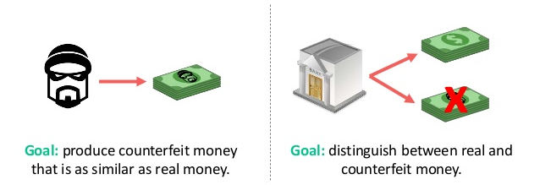
GANs - An Intuition
Notes:
CRIMINAL & POLICE
The generative model can be thought of as analogous to a team of counterfeiters, trying to produce fake currency and use it without detection, while the discriminative model is analogous to the police, trying to detect the counterfeit currency. Competition in this game drives both teams to improve their methods until the counterfeits are indistinguishable from the genuine articles.

Slide 28
GANs - An Intuition
GENERATOR
DISCRIMINATOR
Notes:
The generative model can be thought of as analogous to a team of counterfeiters, trying to produce fake currency and use it without detection, while the discriminative model is analogous to the police, trying to detect the counterfeit currency. Competition in this game drives both teams to improve their methods until the counterfeits are indistiguishable from the genuine articles.

Slide 29
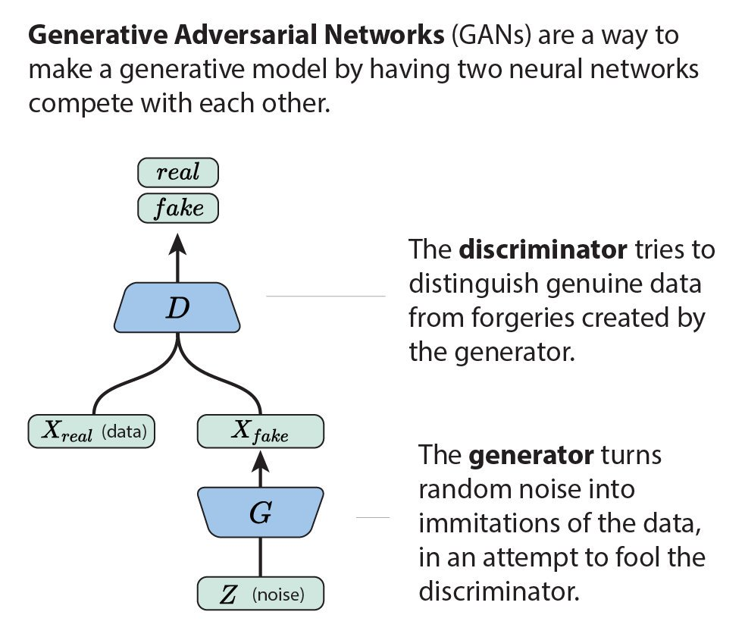
GENERATIVE ADVERSARIAL NETWORKS
Generative model which tries to learn input data distribution and produce realistic results.
2 neural networks are trained simultaneously, competing each other.
DISCRIMINATOR
GENERATOR
Source: https://twitter.com/ch402/status/793911806494261248
Notes:
GENERATOR - tries to fool the discriminator by generating real looking images
DISCRIMINATOR - tries to distinguish between real and fake images

Slide 30
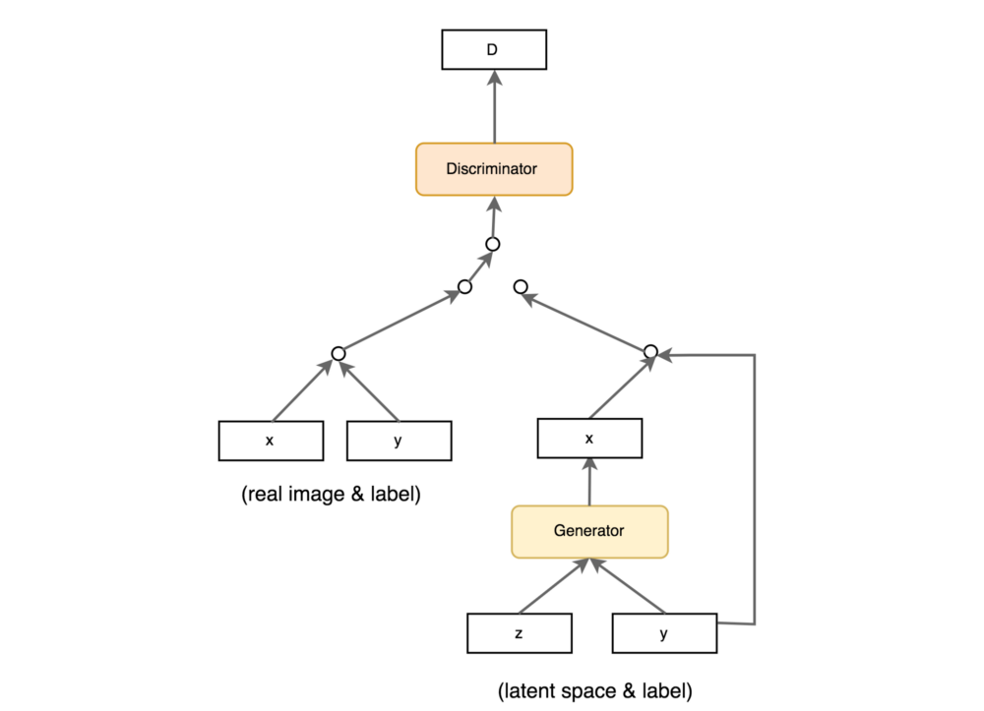
Conditional GAN
Generator learns to generate a fake sample with a specific condition or characteristics (say Y) rather than generating samples from unknown noise distribution.
This condition or characteristic(Y) is fed into both Generator & Discriminator.

Slide 31
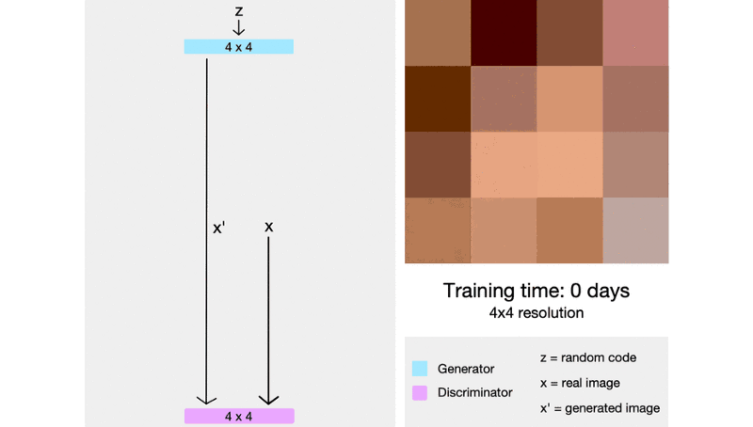
Progressive GAN
ProGAN starts generating low resolution images.
As training advances, a new layer is added and resolution is doubled.
This is continued until desired resolution is reached.
Source: https://towardsdatascience.com/progan-how-nvidia-generated-images-of-unprecedented-quality-51c98ec2cbd2
Notes:
Fading in of new layers.
Initially only high level features are learnt and there as the model progresses we go into the details

Slide 32
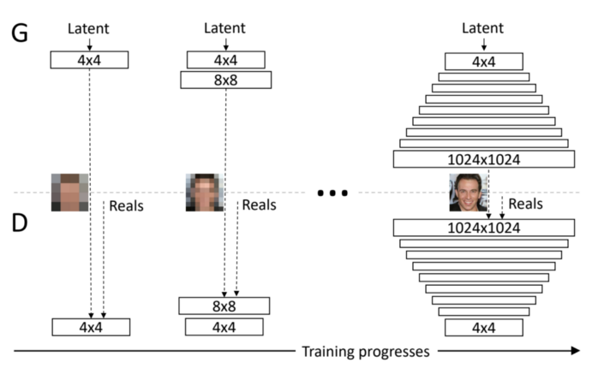
Progressive GAN
Source: https://research.nvidia.com/sites/default/files/pubs/2017-10_Progressive-Growing-of/karras2018iclr-paper.pdf
Notes:
Progressive growing of GANs enables them to get bigger and more stable.
Used to synthesize high resolution images
More efficient in terms of training time than previous GANs

Slide 33
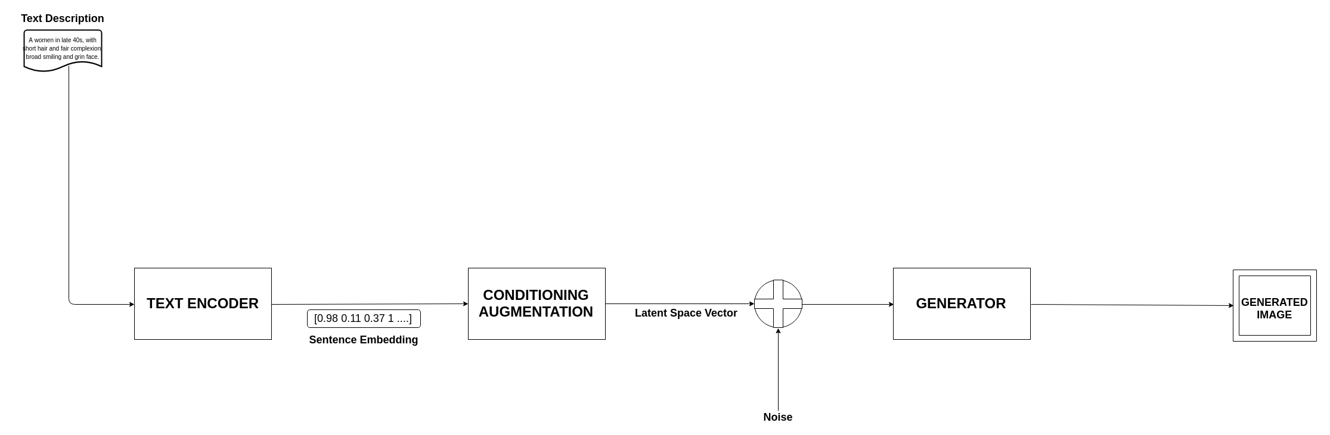
RUNNING THE MODEL

Slide 34
FEATURE TUNING

Slide 35
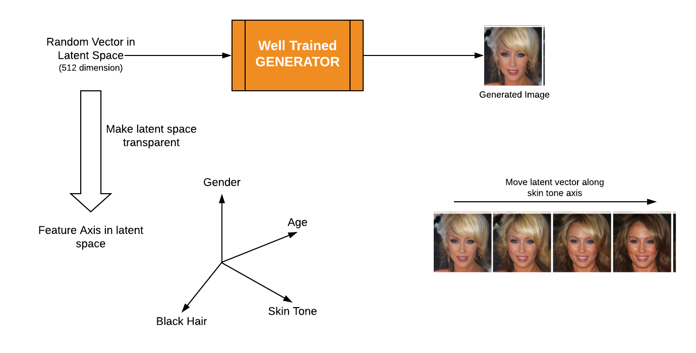
FEATURE TUNING
Enhancing the features to create more realistic images as per the critic by manipulating the latent space vector along the feature axis.
Notes:
Manipulating image features on the generated image.

Slide 36
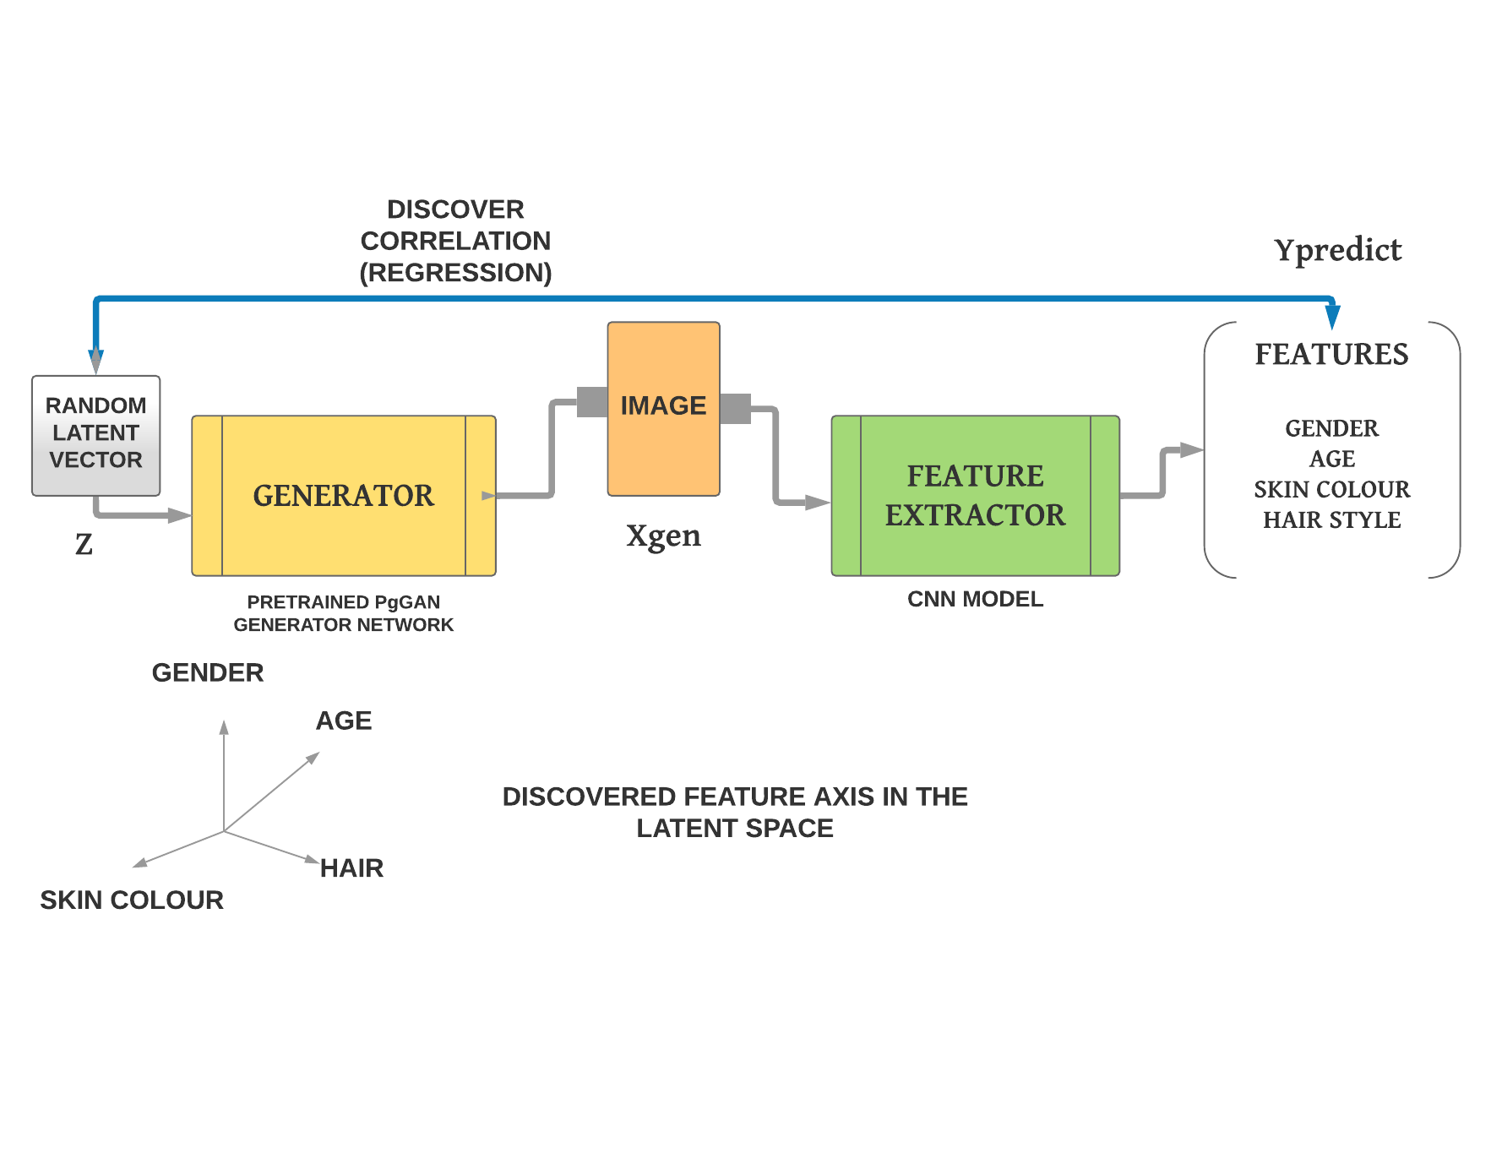
EXTRACTION OF FEATURE AXIS

Slide 37
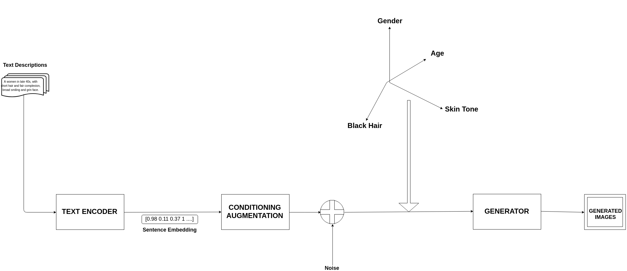
EXTRAPOLATION OF GENERATED IMAGE
Notes:
This diagram shows extrapolation of different features in the generated image.

Slide 38
DEMONSTRATION OF IMAGE GENERATION

Slide 39
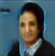


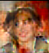
ArtistGAN OUTPUTS
A woman with long black hair and narrow eyes and pointed nose.
ArtistGAN
Man in his 50s, grimacing but does not look upset, he has bags under his eyes.
ArtistGAN
A smiling middle aged man wearing a smart suit. He is wearing a sincere wide smile on his face showing that he is currently happy.
ArtistGAN
A women with blond hair and white face complexion. She has a round face and wide smile.
ArtistGAN

Slide 40
DEMONSTRATION OF FEATURE TUNING

Slide 41
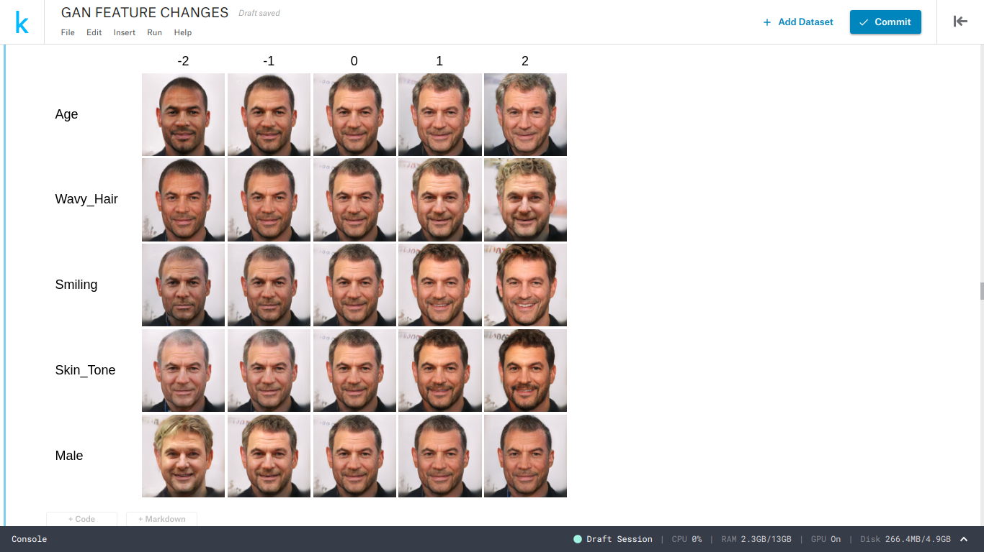
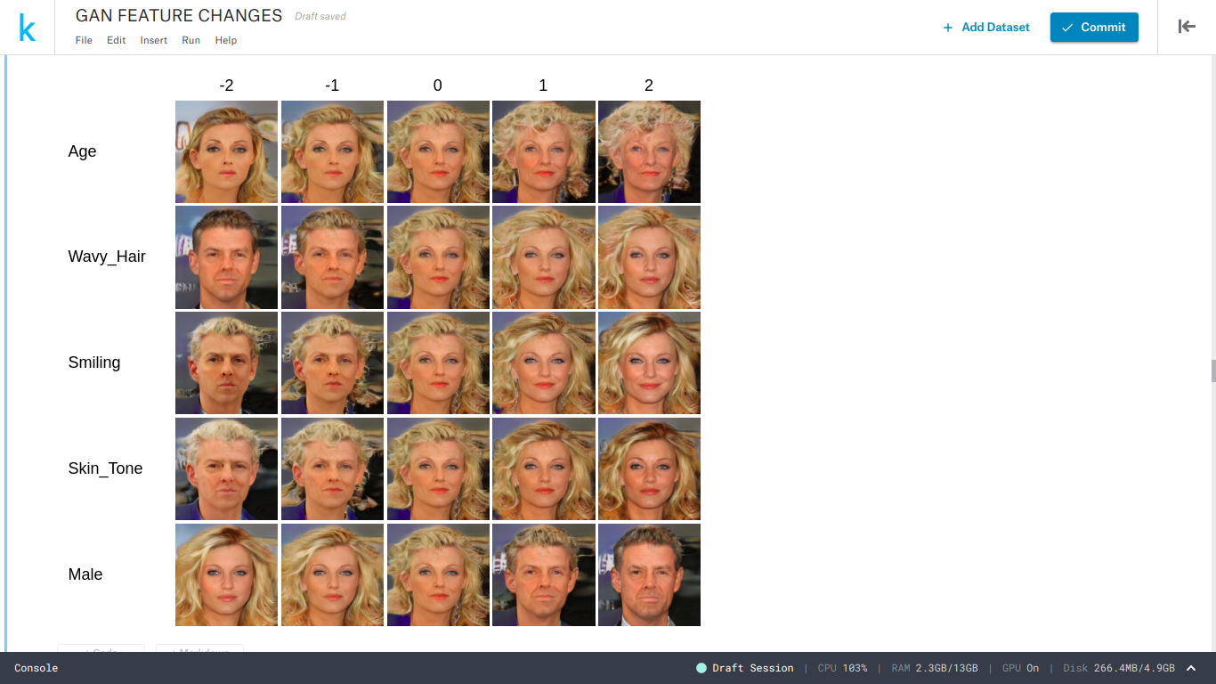
FEATURE TUNING - OUTPUTS

Slide 42
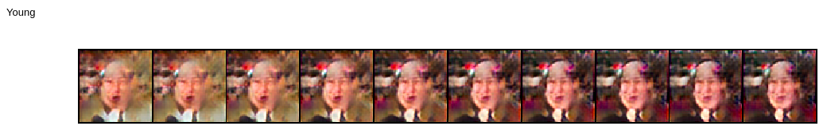
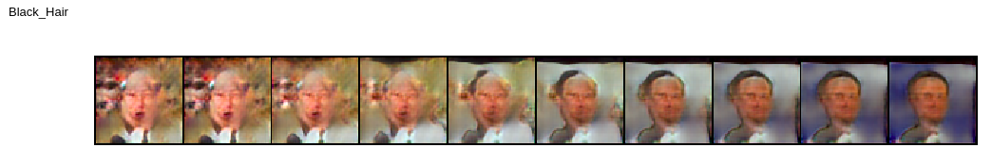
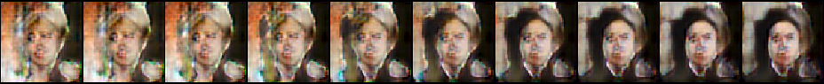
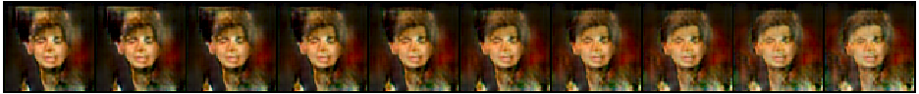
FEATURE TUNING - OUTPUTS
Feature Name | Outputs after extrapolation along feature axis
Young
Black Hair
Male
Pale Skin

Slide 43
Comparison of outputs produced by Vanilla GAN, DC-GAN and ArtistGAN

Slide 44
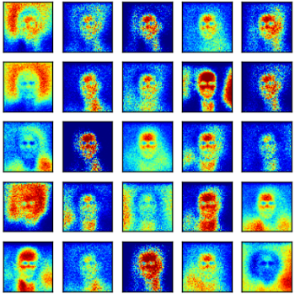
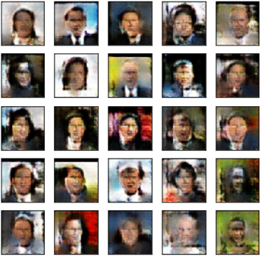
Vanilla GAN
DC-GAN

Slide 45
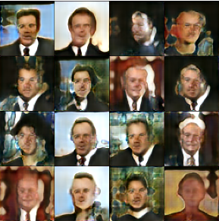
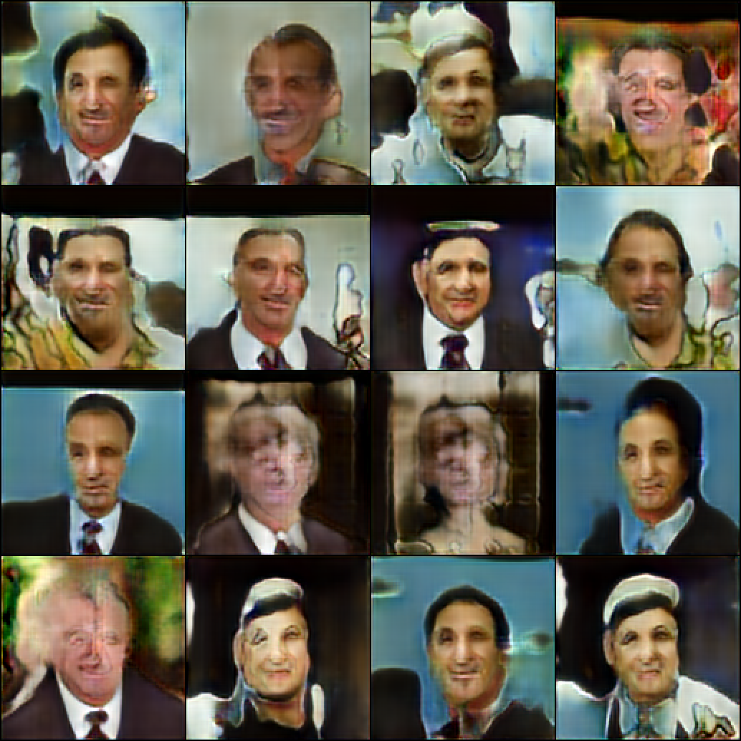
ArtistGAN

Slide 46
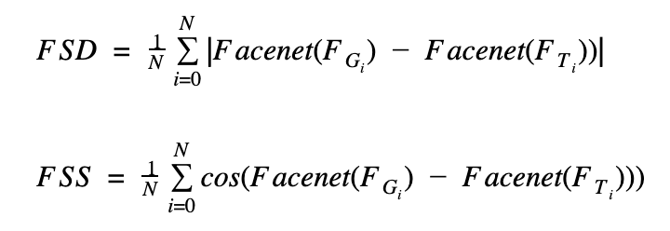
EVALUATION METRICS
We have used the average face semantic distance (FSD) and average face semantic similarity (FSS) between the generated face and the ground-truth image to evaluate our results. The formulas of FSD and FSS are shown below:
Notes:
Inception score metric is not applicable in our model.
We require multiple classes in case of inception score.
Facenet - distance between embeddings directly relates with similarity between faces.
we calculate the euclidean distance and cosine similarity between synthesized faces and ground-truth based on a pretrained face verification network.
Reference : https://ieeexplore.ieee.org/abstract/document/8286933
Quantitative evaluation of results

Slide 47
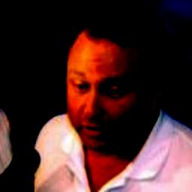
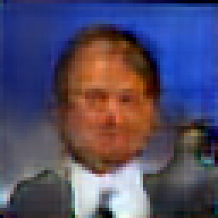
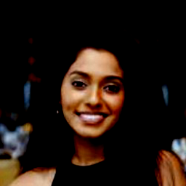
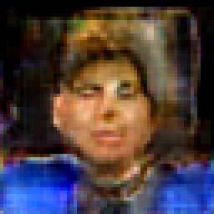
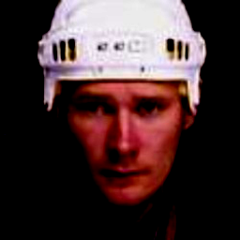
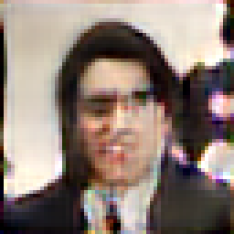
Descriptions | Ground Truth (Real Image) | Generated Image
middle aged man , slightly heavy set with receding hairline . wearing a white cotton or linen shirt looks like he is being interviewed or asked a question
a woman in her 30s , has dark long hair and also dark skin , has dimples when she smiles, has a quite elongated neck, has also one lazy eye .
ice hockey player with a slight squint in one eye

Slide 48
RESULTS
Average FSD and FSS scores for randomly selected inputs on prepared annotated image-description pair dataset:
Method | Face Semantic Distance(FSD) | Face Semantic Similarity(FSS)(%)
DCGAN | 8.465 | 48.9
ArtistGAN | 3.765 | 60.8

Slide 49
EXPERIMENTAL SETUP

Slide 50
EXPERIMENTAL SETUP
Programming language: Python(PyTorch)
Libraries: Numpy, Pillow, Torch, TorchVision, etc.
System Configuration:
Processor: Intel Xeon @ 2.30 GHz
RAM: 16gb
GPU: Google Colab and Kaggle - Tesla T4 and K80
Notes:
Languages:
Libraries:
System Configuration:
Processor:
RAM:
GPU:

Slide 51
CONCLUSION
This architecture can be used as a baseline model for this completely new domain.
The generated images are consistent and in accordance with the input description given. Images can be tweaked to generate images that enriches the textual description.
Generated images can be used as reference images for future research.
A good score of FSS and FSD is obtained from this model.

Slide 52
FUTURE WORK
Creating an improved dataset with better image qualities and descriptions, that will significantly enhance the results.
An effective strategy is required during feature tuning to decrease correlation between features.
Extending the work to create animated faces.
Notes:
Are the results perfect? NO
Research is all about progress

Slide 53
REFERENCES
[1] Goodfellow, I., Pouget-Abadie, J., Mirza, M., Xu, B., Warde-Farley, D., Ozair, S., ... & Bengio, Y. (2014). Generative adversarial nets. In Advances in neural information processing systems (pp. 2672-2680).
[2] Reed, S., Akata, Z., Yan, X., Logeswaran, L., Schiele, B., & Lee, H. (2016). Generative adversarial text to image synthesis. arXiv preprint arXiv:1605.05396.
[3] T. Karras, T. Aila, S. Laine, and J. Lehtinen. Progressive growing of gans for improved quality, stability, and variation. In international conference on learning representations, 2018.
[4] H. Zhang, T. Xu, and H. Li. Stackgan: Text to photo-realistic image synthesis with stacked generative adversarial networks. In international conference on computer vision, pages 5908–5916, 2017.
[5] Schroff, F., Kalenichenko, D., & Philbin, J. (2015). Facenet: A unified embedding for face recognition and clustering. In Proceedings of the IEEE conference on computer vision and pattern recognition (pp. 815-823).
Notes:
ADD REFERENCES

Slide 54
REFERENCES
[6] Conneau, Alexis & Kiela, Douwe & Schwenk, Holger & Barrault, Loïc & Bordes, Antoine.(2017). Supervised Learning of Universal Sentence Representations from Natural Language Inference Data. 670-680. 10.18653/v1/D17-1070.
[7] Z. Liu, P. Luo, X. Wang, and X. Tang. Deep learning face attributes in the wild. In international conference on computer vision, pages 3730–3738, 2015.
[8] Karras, T., Laine, S., & Aila, T. (2018). A style-based generator architecture for generative adversarial networks. arXiv preprint arXiv:1812.04948.
[9] Gary B. Huang, Manu Ramesh, Tamara Berg, and Erik Learned-Miller. Labeled Faces in the Wild: A Database for Studying Face Recognition in Unconstrained Environments. University of Massachusetts, Amherst, Technical Report 07-49, October, 2007.
[10] Gatt, A., Tanti, M., Muscat, A., Paggio, P., Farrugia, R.A., Borg, C., Camilleri, K.P., Rosner, M., & Plas, L.V. (2018). Face2Text: Collecting an Annotated Image Description Corpus for the Generation of Rich Face Descriptions. CoRR, abs/1803.03827.
Notes:
ADD REFERENCES

Slide 55
REFERENCES
[11] Chen, X., Qing, L., He, X., Su, J., & Peng, Y. (2018). From eyes to face synthesis: a new approach for human-centered smart surveillance. IEEE Access, 6, 14567-14575.
[12] Howard, A. G., Zhu, M., Chen, B., Kalenichenko, D., Wang, W., Weyand, T., ... & Adam, H. (2017). Mobilenets: Efficient convolutional neural networks for mobile vision applications. arXiv preprint arXiv:1704.04861.
[13] T. Xu, P. Zhang, Q. Huang, H. Zhang, Z. Gan, X. Huang, and X. He. Attngan: Fine-grained text to image generation with attentional generative adversarial networks. In computer vision and pattern recognition, pages 1316–1324, 2018.
[14] White, T. (2016). Sampling generative networks. arXiv preprint arXiv:1609.04468.
[15] S. Sharma, D. Suhubdy, V. Michalski, S. E. Kahou, and Y. Bengio. Chatpainter: Improving text to image generation using dialogue. arXiv: Computer Vision and Pattern Recognition, 2018.
Notes:
ADD REFERENCES

Slide 56
REFERENCES
[16] Dowson, D. C., & Landau, B. V. (1982). The Fréchet distance between multivariate normal distributions. Journal of multivariate analysis, 12(3), 450-455.
[17] H. Zhang, T. Xu, H. Li, S. Zhang, X. Wang, X. Huang, and D. N. Metaxas. Stackgan++: Realistic image synthesis with stacked generative adversarial networks. IEEE Transactions on Pattern Analysis and Machine Intelligence, pages 1–1, 2018.
[18] J. Yu, Z. Lin, J. Yang, X. Shen, X. Lu, and T. S. Huang. Generative image inpainting with contextual attention. In computer vision and pattern recognition, pages 5505–5514, 2018.
[19] Z. Zhang, Y. Xie, and L. Yang. Photographic text-to-image synthesis with a hierarchically-nested adversarial network. In computer vision and pattern recognition, pages 6199–6208, 2018.
[20] Kiros, R., Zhu, Y., Salakhutdinov, R. R., Zemel, R., Urtasun, R., Torralba, A., & Fidler, S. (2015). Skip-thought vectors. In Advances in neural information processing systems (pp. 3294-3302).
Notes:
ADD REFERENCES

Slide 57
THANK YOU

Slide 58
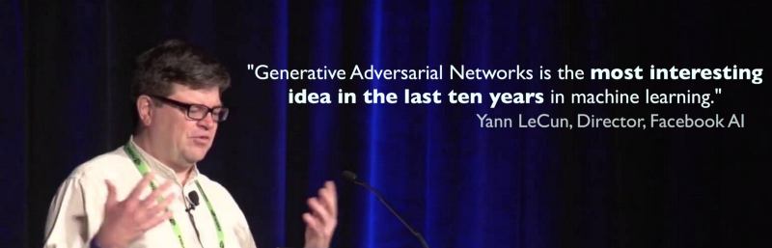
“Generative Adversarial Network is the most interesting idea in the last ten years in machine learning.”

Slide 59
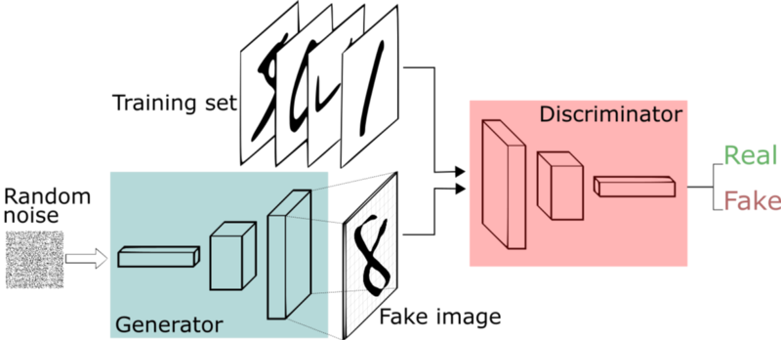
GENERATIVE ADVERSARIAL NETWORKS
Notes:
GENERATOR - tries to fool the discriminator by generating real looking images
DISCRIMINATOR - tries to distinguish between real and fake images

Slide 60
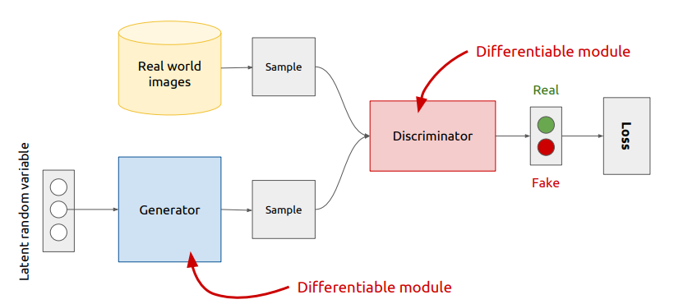
GANs - TRAINING
Alternate between training the generator and discriminator
Source: https://www.slideshare.net/xavigiro/deep-learning-for-computer-vision-generative-models-and-adversarial-training-upc-2016
Notes:
GENERATOR - tries to fool the discriminator by generating real looking images
DISCRIMINATOR - tries to distinguish between real and fake images

Slide 61
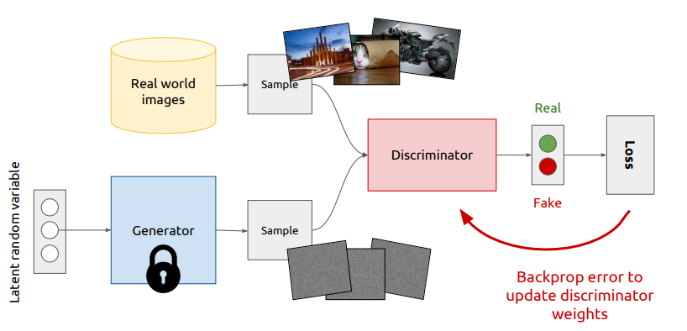
GANs - TRAINING
Fix generator weights, draw samples from both real world and generated images.
Train the discriminator to distinguish between real world and generated images.
Source: https://www.slideshare.net/xavigiro/deep-learning-for-computer-vision-generative-models-and-adversarial-training-upc-2016
Notes:
GENERATOR - tries to fool the discriminator by generating real looking images
DISCRIMINATOR - tries to distinguish between real and fake images

Slide 62
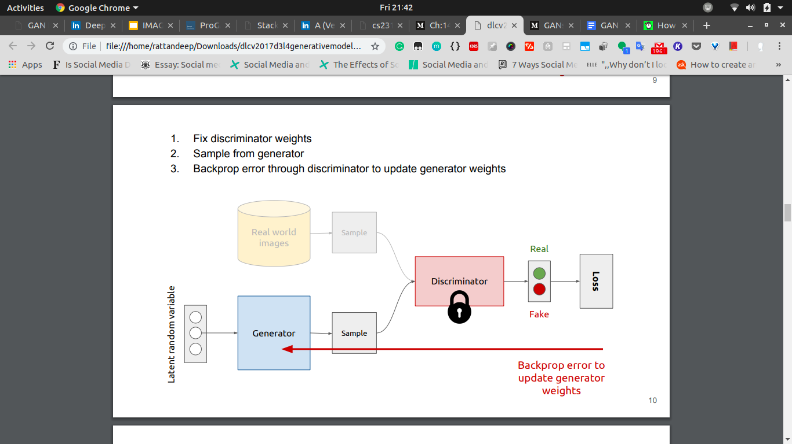
GANs - TRAINING
Fix discriminator weights and sample from generator.
Backprop error through discriminator to update generator weights.
Source: https://www.slideshare.net/xavigiro/deep-learning-for-computer-vision-generative-models-and-adversarial-training-upc-2016
Notes:
GENERATOR - tries to fool the discriminator by generating real looking images
DISCRIMINATOR - tries to distinguish between real and fake images

Slide 63
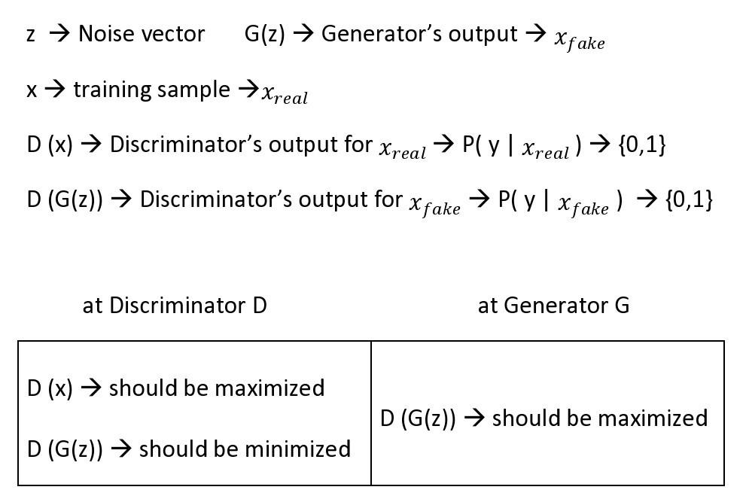
MATHS behind GANs

Slide 64
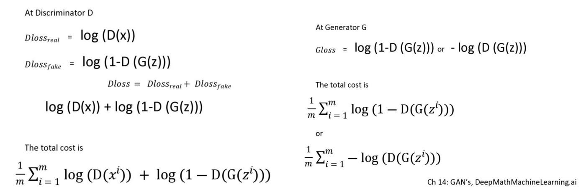
MATHS behind GANs

Slide 65
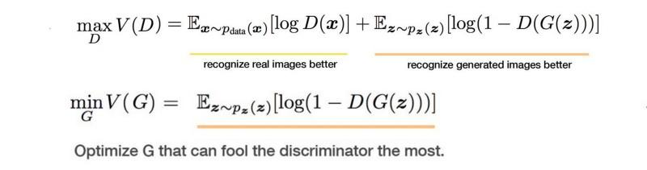
MATHS behind GANs

Slide 66


CONVOLUTION (DISCRIMINATOR)
TRANSPOSED CONVOLUTION (GENERATOR)

Slide 67
GENERATOR | ACT | OUTPUT SHAPE
z||e Projection Conv 4 x 4 Conv 3 x 3 | - Linear ReLU ReLU | 512 1 X 1 X 512 4 X 4 X 512 4 X 4 X 512
Upsample Conv 3 x 3 Conv 3 x 3 | - ReLU ReLU | 8 X 8 X 512 8 X 8 X 512 8 X 8 X 512
Upsample Conv 3 x 3 Conv 3 x 3 | - ReLU ReLU | 16 X 16 X 512 16 X 16 X 512 16 X 16 X 512
Upsample Conv 3 x 3 Conv 3 x 3 | - ReLU ReLU | 32 X 32 X 512 32 X 32 X 512 32 X 32 X 512
Upsample Conv 3 x 3 Conv 3 x 3 | - ReLU ReLU | 64 X 64 X 512 64 X 64 X 256 64 X 64 X 256
Upsample Conv 3 x 3 Conv 3 x 3 | - ReLU ReLU | 128 X 128 X 256 128 X 128 X 128 128 X 128 X 128
Upsample Conv 3 x 3 Conv 3 x 3 Conv 1 X 1 | - ReLU ReLU Linear | 256 X 256 X 128 256 X 256 X 64 256 X 256 X 64 256 X 256 X 3
DISCRIMINATOR | ACT | OUTPUT SHAPE
Input Image Conv 1 X 1 Conv 3 X 3 Conv 3 X 3 Downsample | - ReLU ReLU ReLU - | 256 X 256 X 3 256 X 256 X 64 256 X 256 X 64 256 X 256 X 128 128 X 128 X 128
Conv 3 X 3 Conv 3 X 3 Downsample | ReLU ReLU - | 128 X 128 X 128 128 X 128 X 256 64 X 64 X 256
Conv 3 X 3 Conv 3 X 3 Downsample | ReLU ReLU - | 64 X 64 X 256 64 X 64 X 512 32 X 32 X 512
Conv 3 X 3 Conv 3 X 3 Downsample | ReLU ReLU - | 32 X 32 X 512 32 X 32 X 512 16 X 16 X 512
Conv 3 X 3 Conv 3 X 3 Downsample | ReLU ReLU - | 16 X 16 X 512 16 X 16 X 512 8 X 8 X 512
Conv 3 X 3 Conv 3 X 3 Downsample | ReLU ReLU - | 8 X 8 X 512 8 X 8 X 512 4 X 4 X 512
Minibatch Std Dev Conv 3 X 3 Conv 4 X 4 Fully Connected | - ReLU ReLU Linear | 4 X 4 X 513 4 X 4 X 512 1 X 1 X 512 1 X 1 X 1

Slide 68
Hyperparameter values for text encoder and conditioning augmentation(CA)
Hyperparameter | Value
Caption length ;L | 100
Embedding size ;es | 128
Hidden Size ;hs | 512
Number of layers ;n | 3
CA Size ;e | 256

Slide 69
Hyperparameter values for ArtistGAN
Hyperparameter | Value
Depth ;d | 7
Equalised learning rate ;use_eql | True
Exponential moving average ;use_ema | True
μ for ema ;ema_decay | 0.999
Latent size ;z||e | 512
Learning rate ;alpha | 0.001
Exponential decay rate(Adam optimizer) ;beta1 | 0
Exponential decay rate(Adam optimizer) ;beta2 | 0.99
Adam optimizer constant for stability ;epsilon | 0.00000001
Drift penalty in WGAN-GP ;drift | 0.001
Number of epochs ;epochs | [20,40,40,40,40,40,40]
Fade in percentage ;alpha | [50,50,50,50,50,50,50]
Batch size ;N | [16,16,16,16,16,16,16]
Loss function ;lf | WGAN-GP

Slide 70
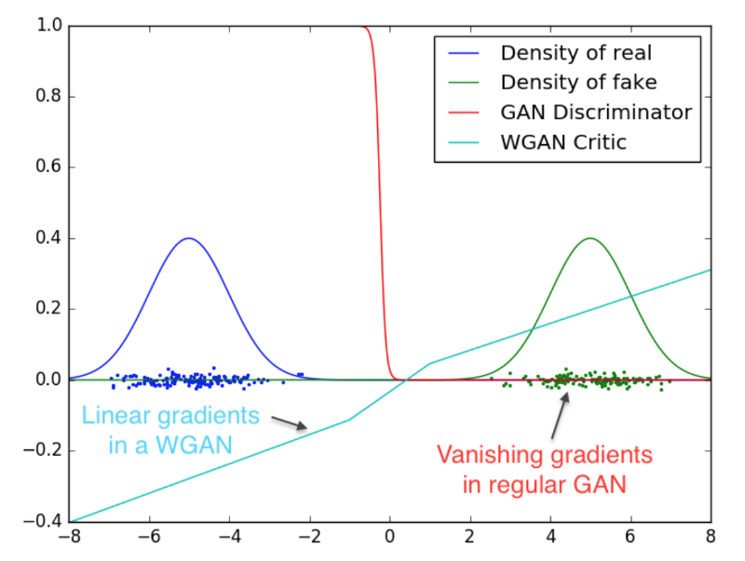
Loss Functions - WGAN-GP
L_{G = -D(x’)}
GP = (( || ⛛ D(ax' + (1-a)x )) ||- 1 )²
^{L}_{D} = -D(x) + D(x’) + λ * GP
The Wasserstein distance is the minimum cost of transporting mass in converting the data distribution q to the data distribution p.

